Slide 1
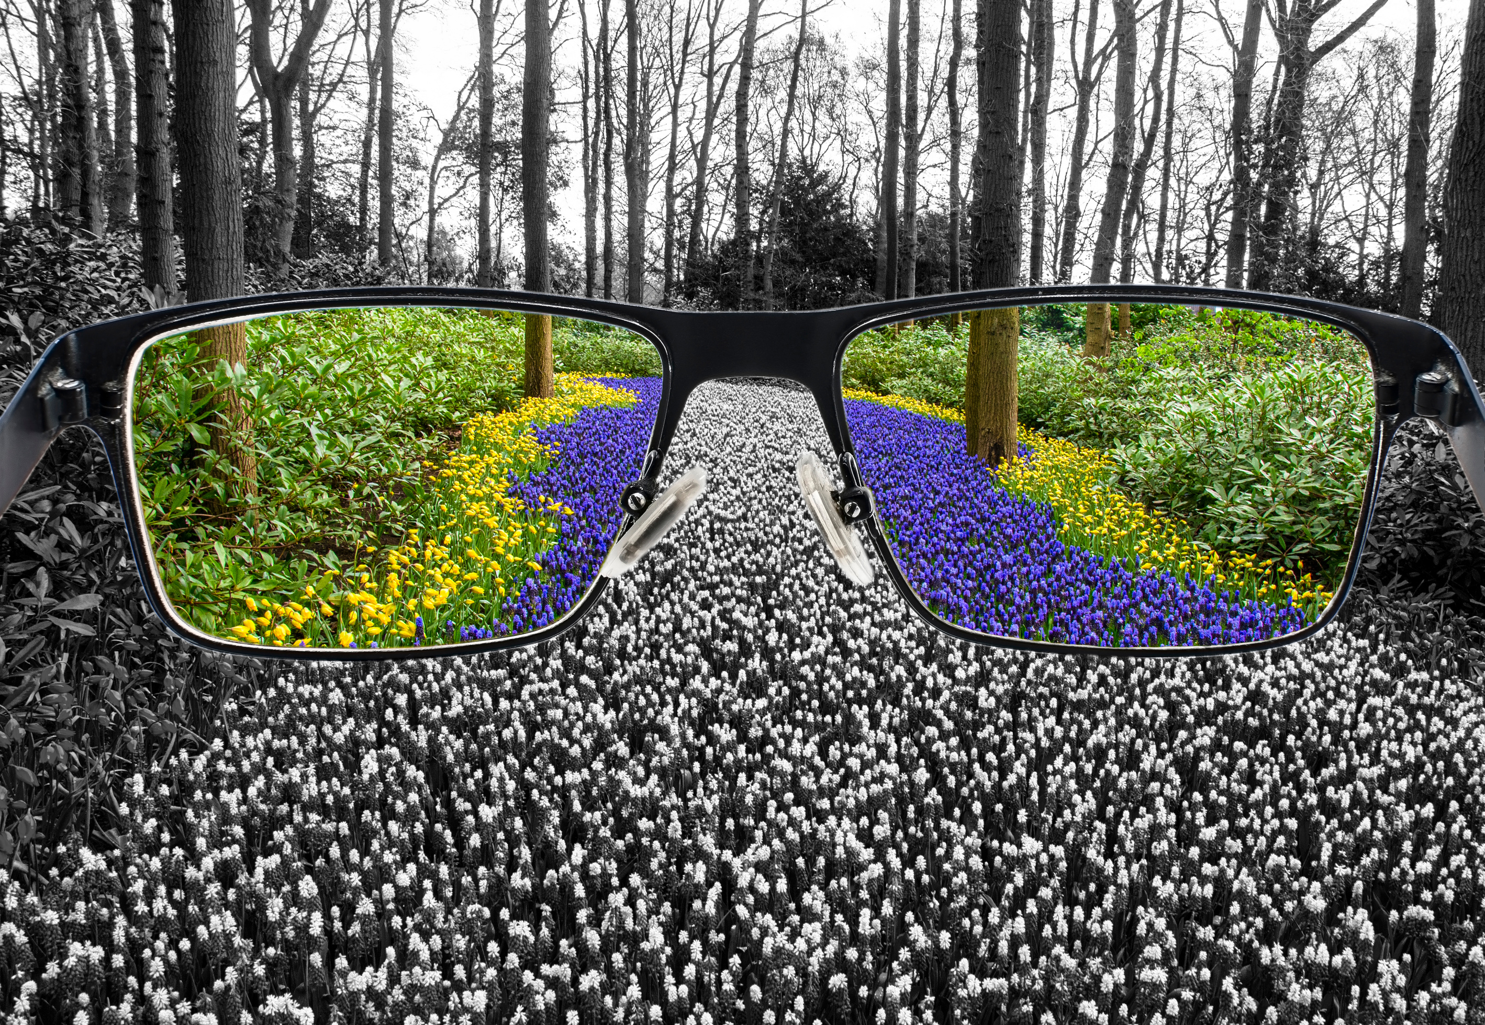



Through
Digital Image Processing

Slide 2
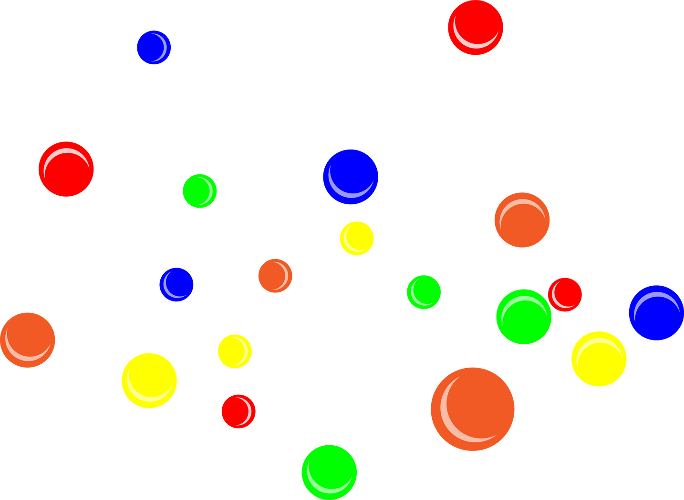


Color Blindness Simulation
Presented By:
Mazhar Abbas-1338
Ahmad Imtiaz-1347
M.Ahmad -1344

Slide 3

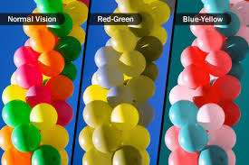
Color Blindness ?
A visual impairment due to various reasons
individuals cannot differentiate between certain colors.

Slide 4
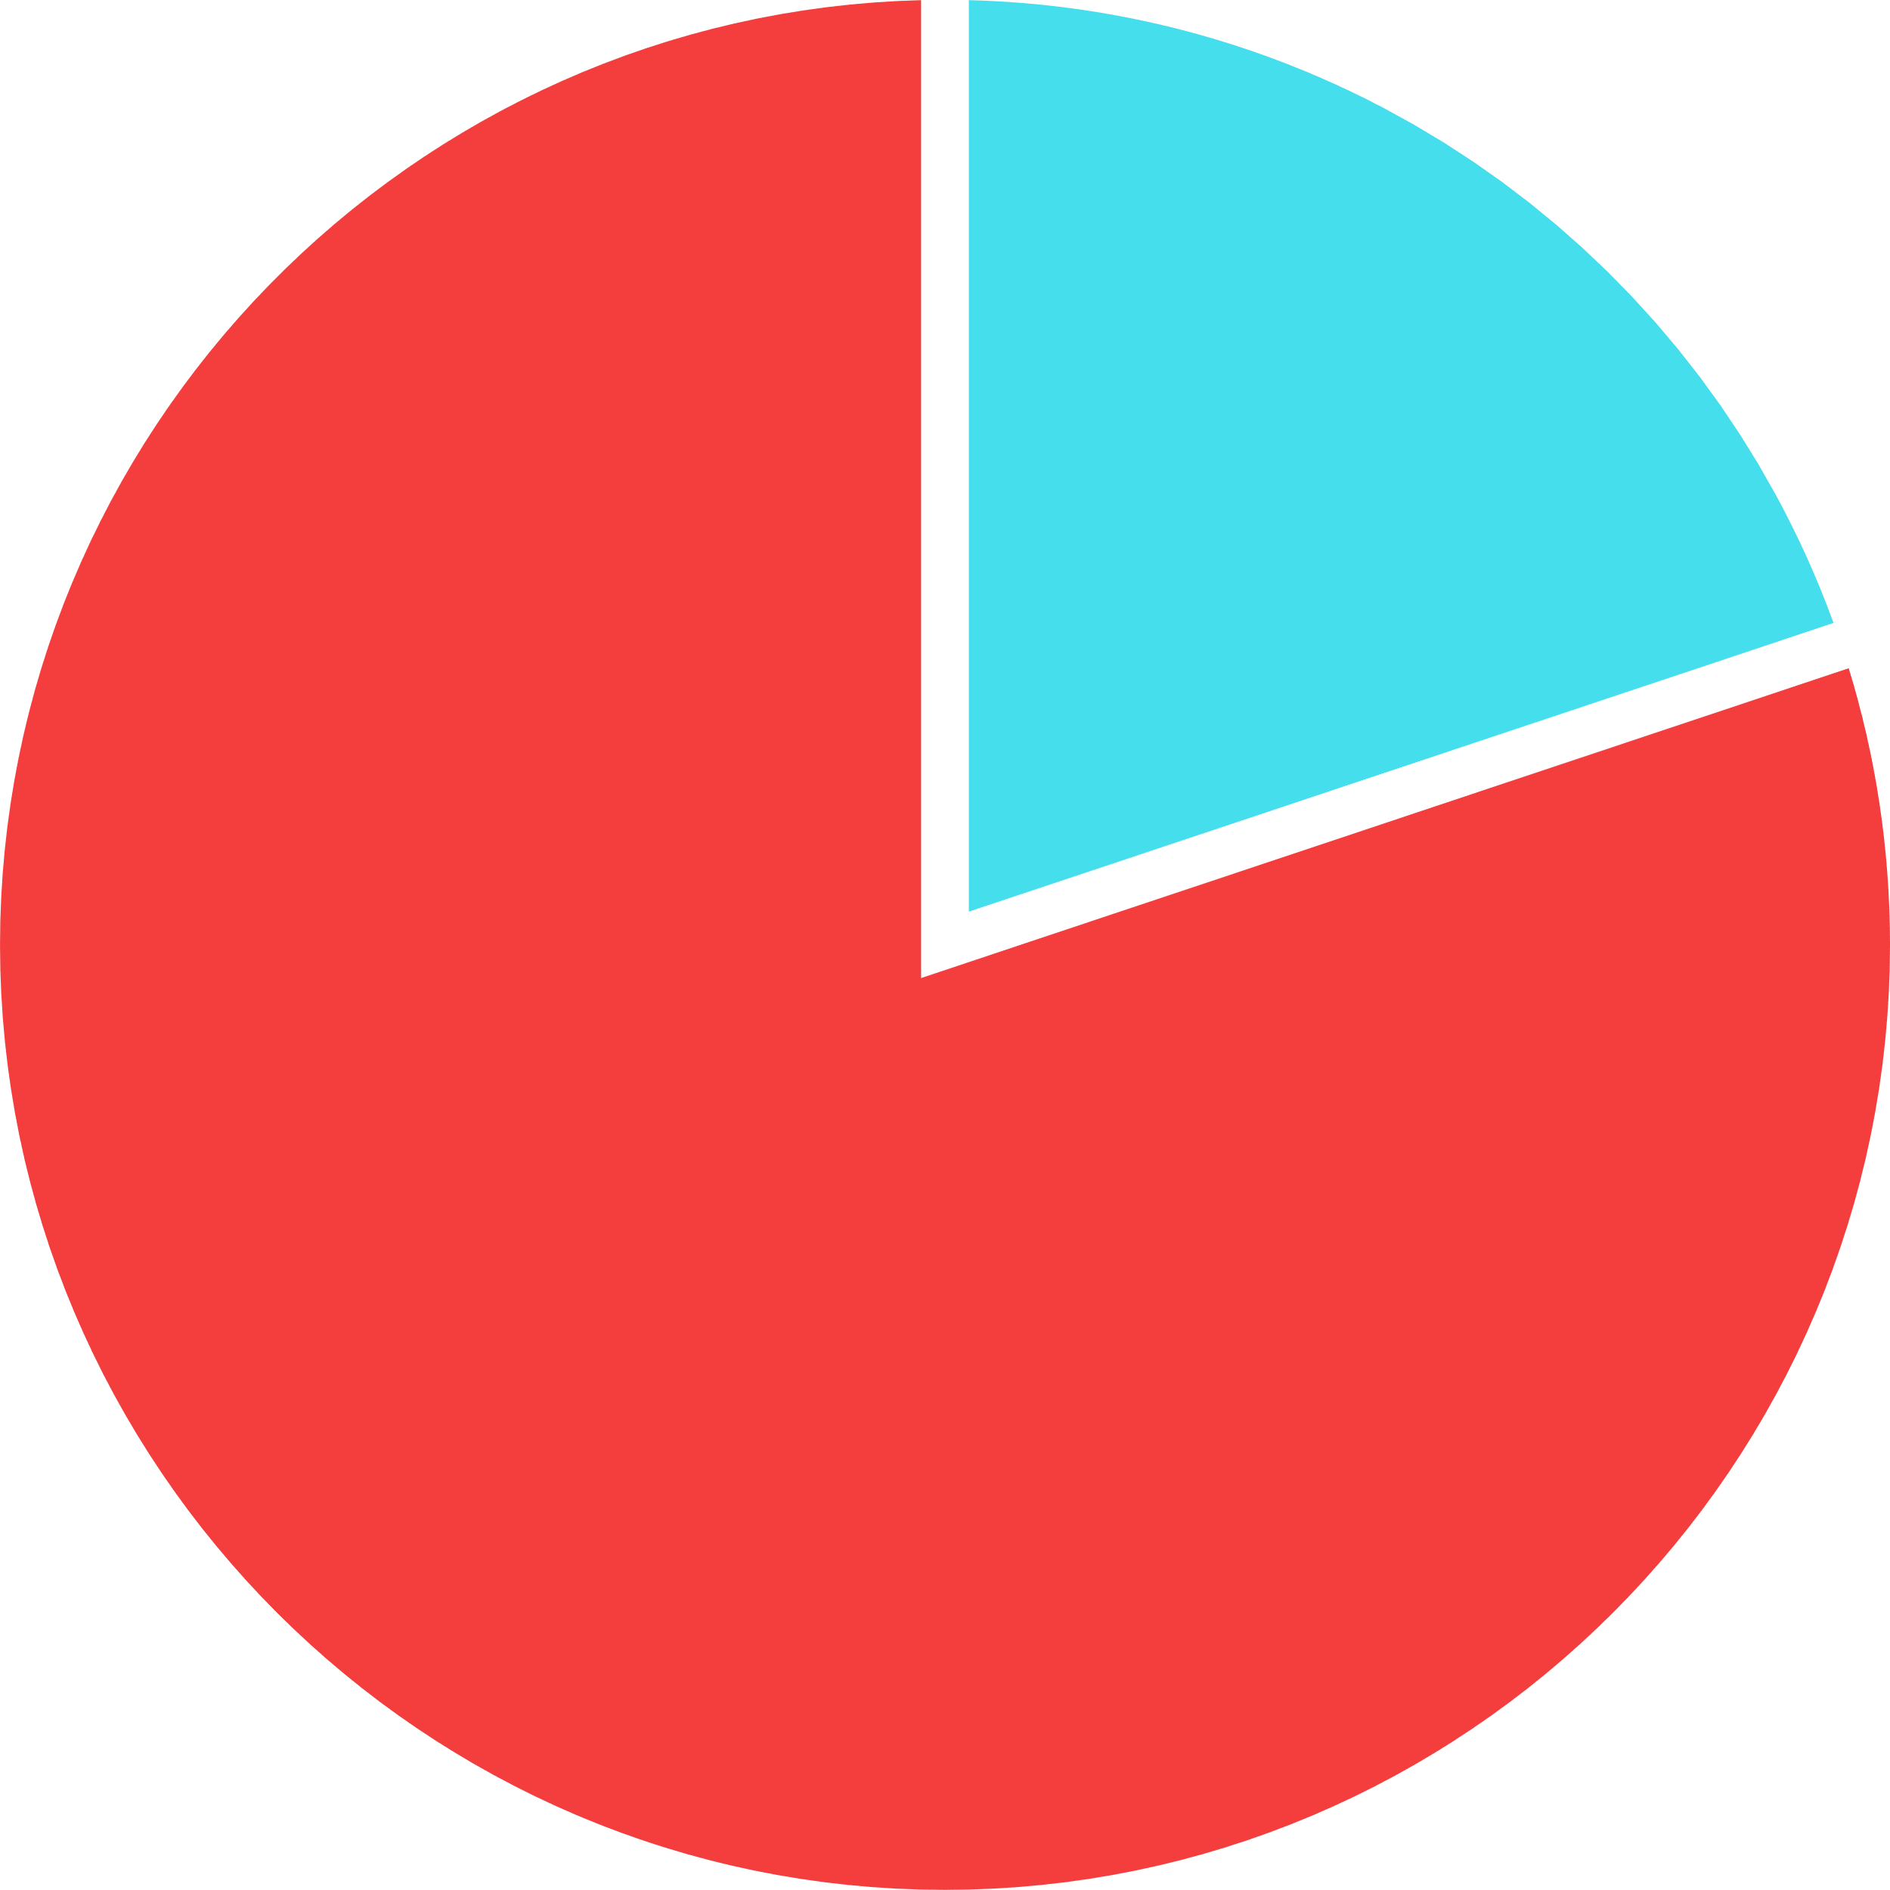
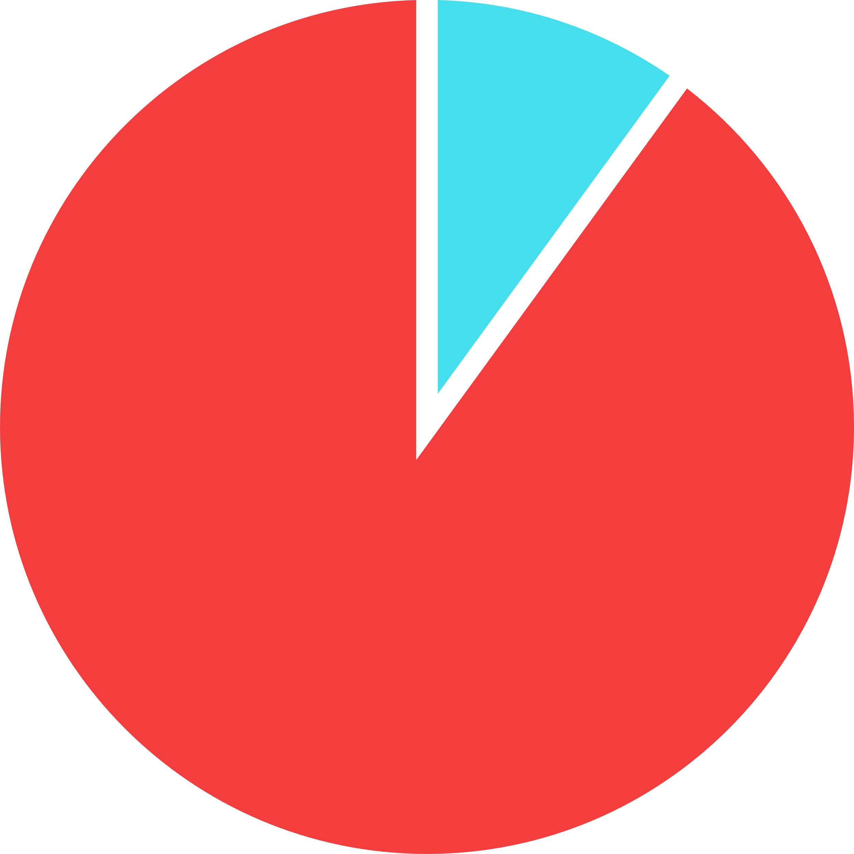




Color Blindness %
0.5 %
5 %
95 %
99.5 %
Male
Female
350M+

Slide 5


Color Blindness Types
Trichromacy
Dichromacy
Monochromacy
Monochromacy
Red-Weak/Protanomaly
Red-Blind/Protanomaly
Green-Weak/Deuteranomaly
Green-Blind/Deuteranomaly
Blue Cone Monochromacy
Blue-Weak/Tritanomaly
Blue-Blind/Tritanomaly

Slide 6
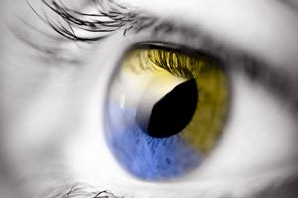
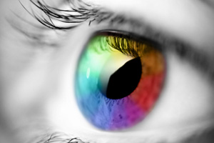
Trichromacy
Normal Vision
Deuteranopia

Slide 7
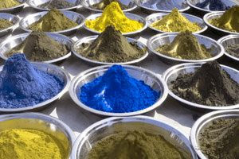
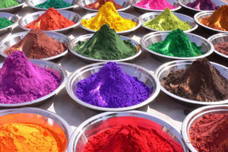
Dichromacy
Normal Vision
Red-Blind

Slide 8
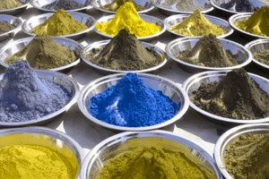
Dichromacy
Normal Vision
Green-Blind

Slide 9
Dichromacy
Normal Vision
Blue-Blind

Slide 10
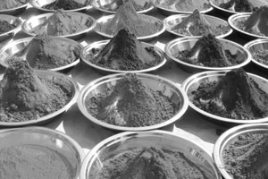
Monochromacy
Normal Vision
Monochromacy

Slide 11
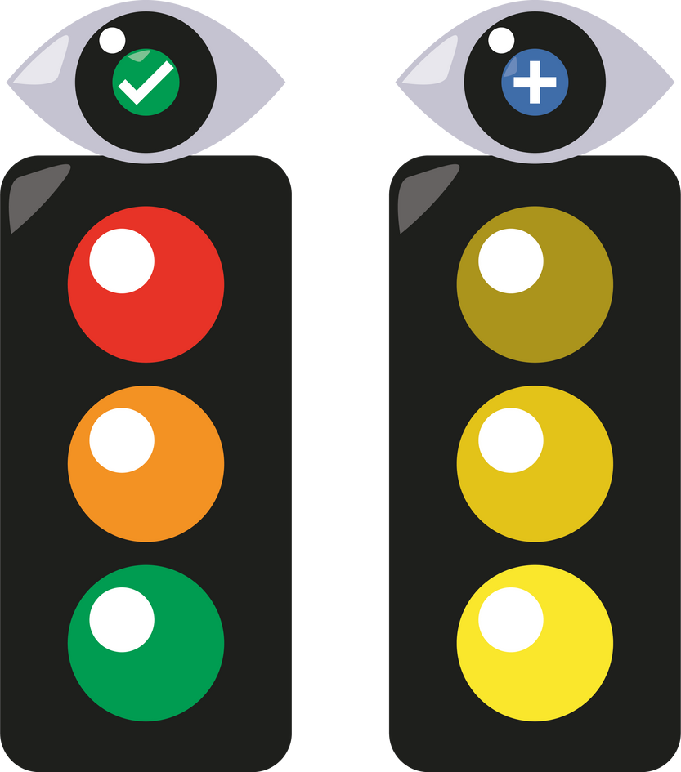

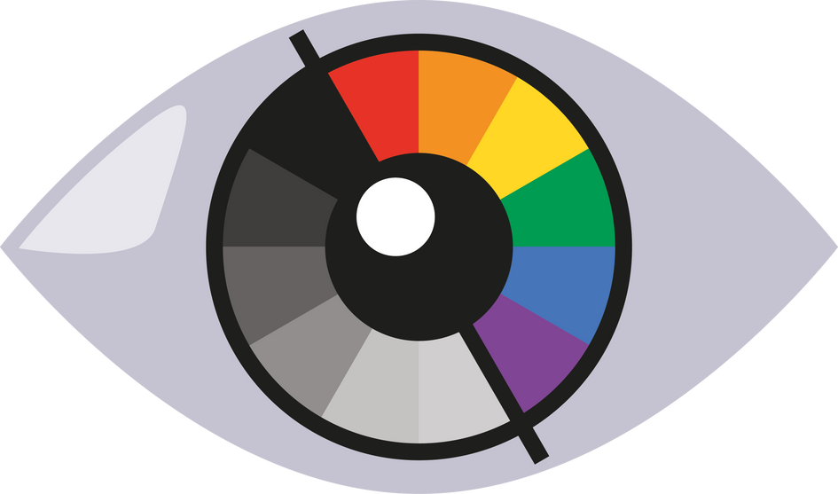
Problem
Challenges Faced by Color-Blind Individuals
Difficulty interpreting traffic signals.
Problems in education/workplace requiring
color identification.
Accessibility issues in digital and physical
environments.

Slide 12

Proposed Solution
Color Blindness Simulation

Slide 13


Features
1.Upload Image
2.Webcam Image
3.Intensity Control

Slide 14



Features
4.Simulation Filter
5.Save Image
6.Reset

Slide 15
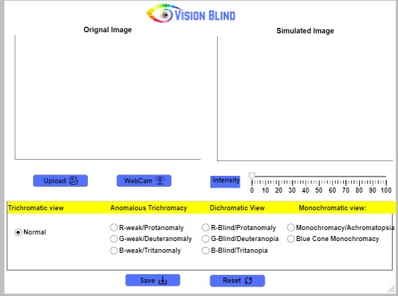
Snapshots

Slide 16
Live-Demo

Slide 17
Any Question?

Slide 18
